Slide 1
Bad news Travel Fast
A Content-based Analysis of Interestingness on Twitter
Presented by: Ashesh P

Slide 2
Agenda
Introduction
Objective
Data Description
Analysis of tweets
Content based retweet prediction
Features
LDA
Regression analysis
Accuracy of retweet prediction
Weights and predictions
Methodology
References

Slide 3
Introduction
On the microblogging site Twitter, users can forward any message they receive to all of their followers. This is called a retweet and is usually done when users find a message particularly interesting and worth sharing with others
Retweeting is a best way to diffuse information, thus retweets diffuse what the Twitter community considers interesting on a global scale

Slide 4
Objective
Objective is to build a predictive model to forecast the likelihood of being a given tweet is retweeted
From the parameters learned by the model we deduce what are the features with influential content that contribute to the likelihood of a retweet
As a result we obtain insights into what makes a message on Twitter worth retweeting and, thus, we can include those tweets in our data set to measure the strength of sentiment and information diffusion

Slide 5
Data description
Three Twitter datasets are used which are collected at different time periods
All datasets consist of a corpus of individual tweets, along with their timestamp and an identification of the user who sent the tweet
The datasets do not explicitly identify retweets. Therefore, in a pre- processing step we detect the retweets in the data by using the patterns
TweePy API is used to collect data from Twitter, JSON data is collected

Slide 6
Data pre-processing
Raw data from Twitter collected in JSON files
Analyze data and find patterns
Feature Selection
Data Parsing

Slide 7
Patterns
Patterns used in retweets
RT @[username]…..
….(via@[username])
retweeting @[username]…
retweet @[username]…

Slide 8
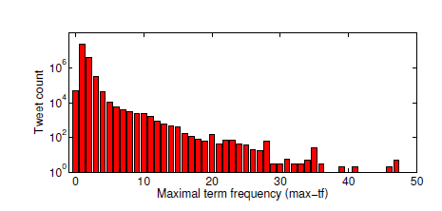
Analysis of tweets
Due to shortness of tweets they contain few words and hardly ever contain a word multiple times in a single tweet
85% of tweets do not contain any term more than once
This scenario makes terms frequency measure essentially inefficient

Slide 9
Content based retweet prediction
A tweet is actually retweeted or not generally depends heavily on context, such as the user's position in the social graph or the time of day the tweet is posted
A tweet of a user with few or passive followers is less likely to be retweeted
Tweets posted in the night tend to get retweeted less
This contextual piece of data has very less influence on the content of tweet. To avoid contextual bias, features are extracted from the content of the tweet itself

Slide 10
Features
Features that are selected during data parsing
Direct message {0,1}
Include username {0,1}
Include hashtag {0,1}
Include URL {0,1}
Exclamation mark {0,1}
Question mark {0,1}
Term positive {0,1}
Term negative {0,1}
Emoticon positive {0,1}
Emoticon negative {0,1}
Valence [-5, +5] (pleasure vs displeasure)
Arousal [-5, +5] (excitement vs calmness)
Dominance [-5, +5] (weakness vs strength)
Terms [0,1]
Topics [0,1]

Slide 11
Features
Direct messages are addressed to another user directly. Direct messages are a kind of public conversation, rather than general broadcast of information
URLs, usernames and hashtags in Twitter are identified by their specific syntax using the pattern @username, #hashtag, and http: respectively. Usernames are used to refer other users or addressing a user that we are talking about. Hashtags are used to mark specific topics. URLs are universally used to mark specific topics
Exclamation and question marks are used at the end of tweets to strengthen the tweet. Exclamation marks are used to mark strong and potentially emotional statements. Question marks extend their reach and find an expert capable of providing an answer

Slide 12
Features
Positive and negative terms play a role in making a tweet interesting or uninteresting. Strong positive and negative terms might support a retweet as a sign of support among users
Emoticons are short character sequences representing emotions
Sentiments are captured as valence (pleasure vs displeasure), arousal (excitement vs calmness) and dominance (weakness vs strength)

Slide 13
Porter Stemmer
It is a stemming algorithm, goal of stemming is to reduce variations of each word due to inflection or derivation to a common word.
Improves effectiveness by providing a better match between query and a relevant document
User who is searching for word ‘swimming’ might be interested in documents with ‘swim’
Many words with different meanings have common stems ( e.g.; fabricate and fabric)

Slide 14
Latent Dirichlet Allocation
Each tweet is limited to 140 characters with heterogeneous vocabulary written in a language unlike standard written English
Modelling twitter content requires methods that are suitable for short texts with heterogeneous vocabulary with minimum supervision
One such method which works well on short texts for modelling topics is LDA
Jensen-Shannon Distance is used in LDA
Jensen-Shannon Distance is a standard way to measure similarities between two probability distributions (0 being close 1 being very far)

Slide 15
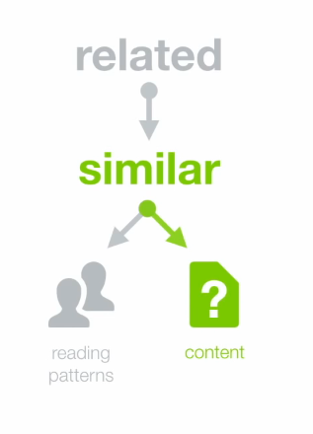
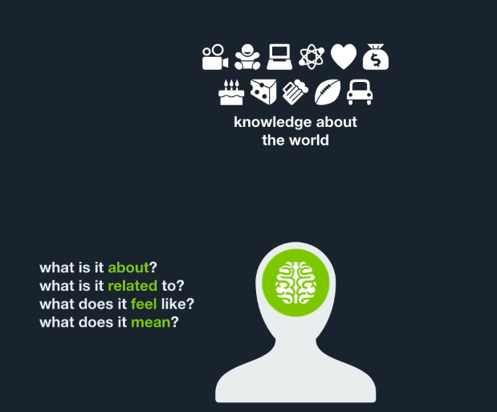
LDA
How to find the context of a document ?

Slide 16



LDA

Slide 17
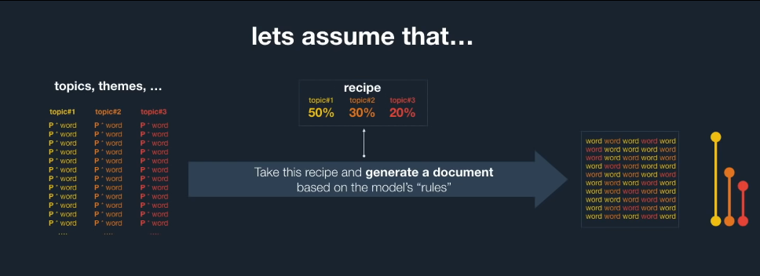
LDA

Slide 18
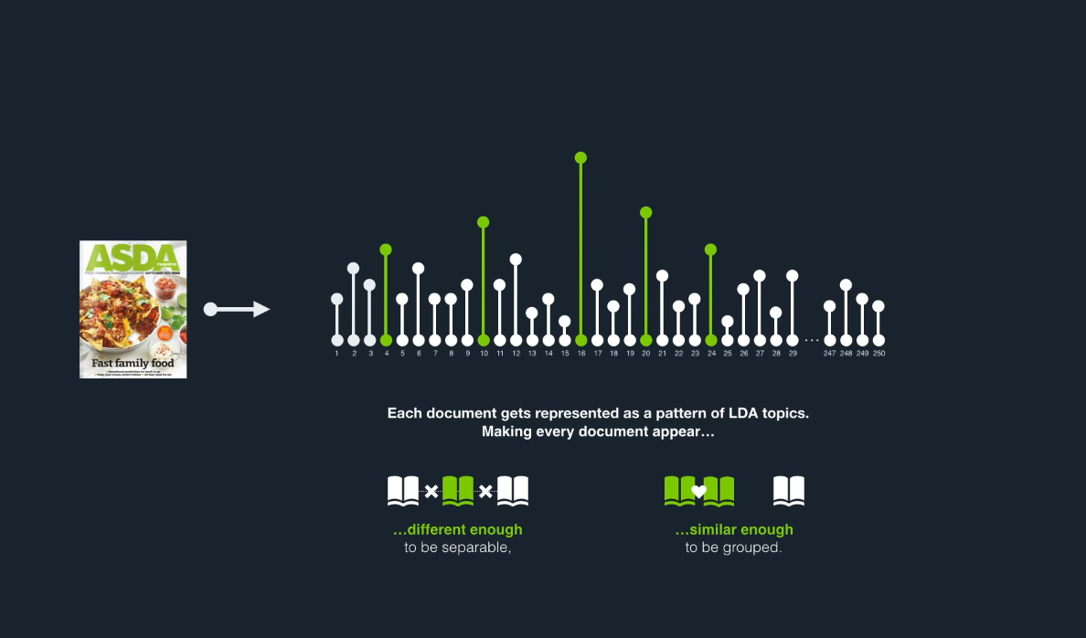
LDA

Slide 19
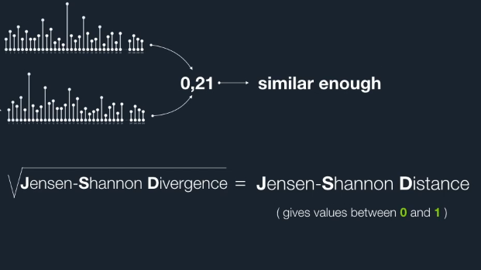
LDA

Slide 20
Logistic regression
Logistic regression is used to compute the probability of a new tweet being retweeted
Logistic regression is a generalized regression method for learning when the variables are binary or dichotomous
Weights wi learned by logistic regression can be interpreted as the log-odds for the feature i
Positive weights denote a higher probability of a tweet being retweeted

Slide 21
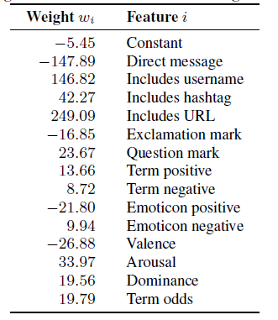
Analysis of weights

Slide 22
Analysis of weights
Direct messages are unlikely to be tweeted, which is indicated by strong negative score. Personal tweets are of no interest on a global scale
Messages with hashtags, usernames and URLs are likely to be retweeted
Sentiments play an important role in retweeting. Weights need to be interested slightly in a different way. Tweets with negative valance values like displeasure contends tend to get tweeted more often
Negative emoticon increases the probability of retweet
Terms are strong indicator for a retweet

Slide 23
Example: Interesting tweets
These are the tweets where retweet probabilities are high
How to make potato latkes video recipe by @hand How to make potato latkes video recipe by @handmadekitchen http://tinyurl.com/n22t4p #cooking#recipe
what to pack for a day at the beach with the fam (plus a yummy beach pasta salad recipe) http://is.gd/1sBKM #ocmom #recipe

Slide 24
Example: Interesting topics
These are the topics where retweet probabilities are high
Social media market post site web tool traffic network
Christmas shop tree x mas present today wrap finish

Slide 25
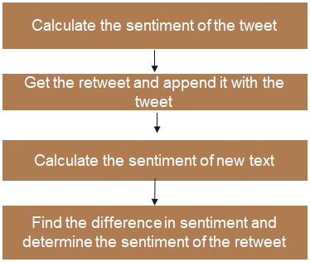
Present Research Status

Slide 26
References
Rui, T., Cui, P., & Zhu, W. (2017). Joint user-interest and social-influence emotion prediction for individuals. Neurocomputing, 230, 66-76.
Blei, D. M., Ng, A. Y., & Jordan, M. I. (2003). Latent dirichlet allocation. Journal of machine Learning research, 3(Jan), 993-1022.
Referred from a video tutorial by Andruis Knispelis on LDA Topic Models, https://www.youtube.com/watch?v=3mHy4OSyRf0&t=575s
Liu, Z., Yu, W., Chen, W., Wang, S., & Wu, F. (2010, December). Short text feature selection for micro-blog mining. In Computational Intelligence and Software Engineering (CiSE), 2010 International Conference on (pp. 1-4). IEEE.
http://sentistrength.wlv.ac.uk

Slide 27


